Slide 1

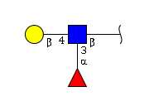
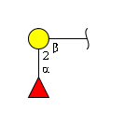
Galalpha1-3Gal epitope, Lactosamine motif, Blood group H
Lactosamine motif, Blood Group H
All other motif sets

